Slide 1
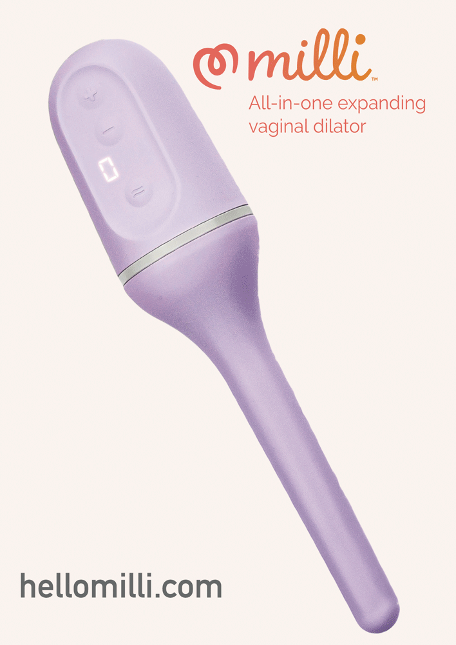
Milli Expanding Vaginal Dilator with optional vibration (15mm to 40 mm)

