Slide 1
A sub-analysis comparing subjects experienced with static dilators vs. naïve to dilation from the POMPOM study evaluating the efficacy of the Milli Expanding Dilator as a treatment for achieving intercourse.
Sheryl Kingsberg, Ph.D., University Hospitals Cleveland Medical Center

Slide 2
Disclosures & Acknowledgments
Advisory Board Fee/Consultant Fee:
Astellas Pharma
Aviva
Bayer
Daré Bioscience
Freya
Futura Medical
Madorra
Materna Medical
Mithra
Palatin
Pfizer Inc.
Reunion Neuroscience
ReJoy
Sprout Pharmaceuticals, Inc.
Shares/Restricted Stock Units:
Alloy
J3 Bioscience
Board of Directors:
J3 Bioscience
Strategic Science & Technologies:
Ms. Medicine
Vella Biosciences
POMPOM Study Acknowledgements:
Funded by Materna Medical, Inc.
WCG IRB Tracking Number—20241369
ClinicalTrials.gov—NCT06397885
I will be discussing off-label uses of the following drugs/devices: None

Slide 3
Introduction
Vaginal dilators are recommended tools for managing lifelong/acquired vaginismus and dyspareunia.
However, static, rigid dilators often present significant patient barriers, including discomfort, difficulty with insertion, and the need to manage multiple sizes.
These challenges often result in poor adherence and suboptimal outcomes.
A single, expandable dilator that increases in one-millimeter increments may offer meaningful advantages, including simplified logistics and improved patient adherence.
The Milli expandable dilator combines gradual mechanical expansion with optional vibration, representing a novel approach to address limitations.
POMPOM participants included:
39.8% with previous dilator experience
of which 56.8% had discontinued by 6 months, suggesting a hard-to-treat subgroup.
These participants primarily purchased¹ the Milli because it was too difficult to advance to larger-sized static dilators.

Slide 4
56.8% of Static Dilator Users Stopped within 6 months & Main Reason Why (n=37)
*Other Specify
Pain while reinserting
Got to medium and have not been able to progress
It was hard to motivate myself to do something that I found painful
My husband was away for a couple of months, so didn’t try during that time

Slide 5
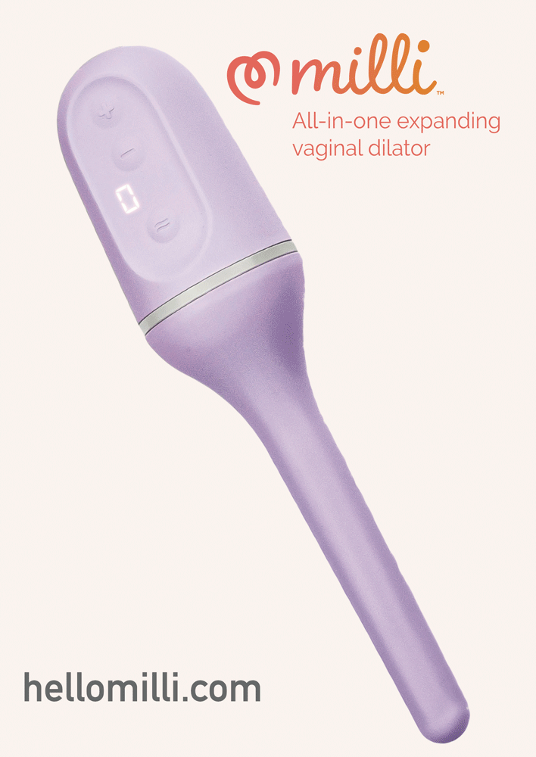
Objective
This longitudinal web-based observational study’s purpose is to assess the efficacy of an expandable dilator, in self-directed use, to resolve vaginismus and pain with heterosexual intercourse.
Sub-analysis compares experienced vs. naive dilator users.

Slide 6
Methods
Primary Endpoint Questionnaire (PEQ)
Date: | Instructions: Put an “X” in the column that best describes your experience during the last 4 weeks; add the numbers from each column together
PEQ Total (0-21):
Penetration Types | 0 = Not Attempted | 1 = Attempted, but unsuccessful | 2 = Attempted, and sometimes successful | 3 = Attempted, and always successful
Full vaginal penetration with the penis of the partner
Self-insertion in the vagina of one (1) finger by the woman
Self-insertion in the vagina of two (2) fingers by the woman
Insertion in the vagina of one (1) finger by the partner
Insertion in the vagina of two (2) fingers by the partner
Self-insertion in the vagina of another object (such as a tampon or a dildo) by the woman
Self-insertion in the vagina of another object (such as a tampon or a dildo) by the partner
Participants who signed an Informed Consent, submitted answers to baseline questionnaires on demographics, symptoms associated with dyspareunia (inability to have vaginal penetration, sexual function, penetration pain), previous treatments, and dilator experience.
Participants qualified for inclusion after meeting DSM-5 criteria for GPPPD/vaginismus and inability to achieve intercourse, behavioral function primary endpoint questionnaire (PEQ)² Item 1 score of 0 (“not attempted”) or 1 (“attempted but unsuccessful”).
Seventy-four participants completed the required initial use form, 68 and 63 completed follow-up assessments at 3 and 6 months, respectively.
Participants self-guided their use of the Milli expanding vaginal dilator with vibration from written instructions.

Slide 7
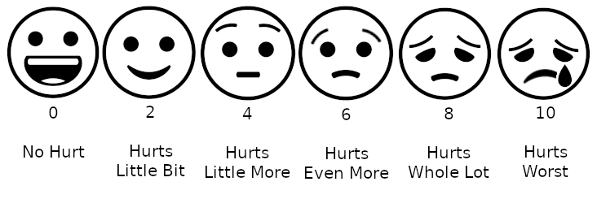
Methods
Female Sexual Function Index (FSFI) Scoring
Desire: | Sum of items 1-2 x 0.6
Arousal: | Sum of items 3-6 x 0.3
Lubrication: | Sum of items 7-10 x 0.3
Orgasm: | Sum of items 11-13 x 0.4
Satisfaction: | Sum of items 14-16 x 0.4
Pain: | Sum of items 17-19 x 0.4
Participants rated dilation therapy progress at 3 and 6 months using validated questionnaires.
Successful heterosexual intercourse was measured using PEQ² Item 1 (successful penile insertion, scale of 0 = not attempted to 4=attempted, always successful).
The Female Sexual Function Index (FSFI) ³ provided a total score and subdomain scores—desire, arousal, lubrication, orgasm, satisfaction, and pain.
Participants also separately rated pain and anxiety with intercourse from 0 (no pain/anxiety) to 10 (extreme pain/anxiety). ⁴
Subjects reported goal progress for return to intercourse, less painful sex, and maximum dilator size reached.
Visual Analog Scale (VAS) for Pain and Anxiety

Slide 8
Results
Experienced dilator users reported lower baseline FSFI scores and similar pain and anxiety with intercourse ratings compared to naive users.
Improvements in FSFI and pain/anxiety with intercourse were statistically significant in both cohorts at 3 months.
The Milli maximum dilation average for experienced (32.6 mm) and naive (32.3 mm) participants falls between sizes 6 and 7 in two commonly used 8-device static kits.
The average degree of improvement in PEQ-1 was statistically significant (versus zero) for the naive group at 3 and 6 months and the experienced group at 6 months.

Slide 9
Table 1. 3-mo Interim Comparative Analysis
% improvement from baseline | Experienced (n=33) | Naive (n=35)
Pain with Intercourse | 22.5% (p=0.0028) | 27.8% (p=0.0001)
Overall FSFI | 35.1% (p=0.0080) | 24.4% (p=0.0116)
Making Progress Toward or Met Return to intercourse (goal) | 84.8% | 85.7%
Reported Maximum Diameters Reached (Average) | 32.6mm | 32.3mm
Anxiety | 15.8% (p=0.0291) | 24.2% (p=0.0022)
FSFI Sub-Domains
1-Desire | -2.9% (p=0.6999) | -3.1% (p=0.5912)
2-Arousal | 33.9% (p=0.0394) | 12.8% (p=0.2669)
3-Lubrication | 28.1% (p=0.0302) | 21% (p=0.0941)
4-Orgasm | 34.9% (p=0.0837) | 15.9% (p=0.1609)
5-Satisfaction | 62.4% (p=0.0010) | 42.5% (p=0.0023)
6-Pain | 161.8% (p=0.0006) | 155.6% (p<0.0001)

Slide 10
Table 2. Primary Endpoint: PEQ Item 1 (Ability to achieve intercourse with a partner)
Experienced |  | Naive
3 months (n=33) | 6 months (n=30) | 3 months (n=35) | 6 months (n=33)
12.0% (p=0.6091) | 54.2% (p=0.0349) | 50.0% (p=0.0370) | 78.0% (p=0.037)
52.9% of participants who attempted intercourse were successful | 65% of participants who attempted intercourse were successful | 68.2% of participants who attempted intercourse were successful | 81.8% of participants who attempted intercourse were successful
Participants with Prior Dilator Experience made some progress at 3 months and continued to make progress at 6 months.

Slide 11
Table 2. Primary Endpoint: PEQ Item 1 (Ability to achieve intercourse with a partner)
Participants with NO Prior Dilator Experience made significantly more progress at 3 months and 6 months.
Experienced |  | Naive
3 months (n=33) | 6 months (n=30) | 3 months (n=35) | 6 months (n=33)
12.0% (p=0.6091) | 54.2% (p=0.0349) | 50.0% (p=0.0370) | 84.6% (p=0.0030)
52.9% of participants who attempted intercourse were successful | 65% of participants who attempted intercourse were successful | 68.2% of participants who attempted intercourse were successful | 81.8% of participants who attempted intercourse were successful

Slide 12
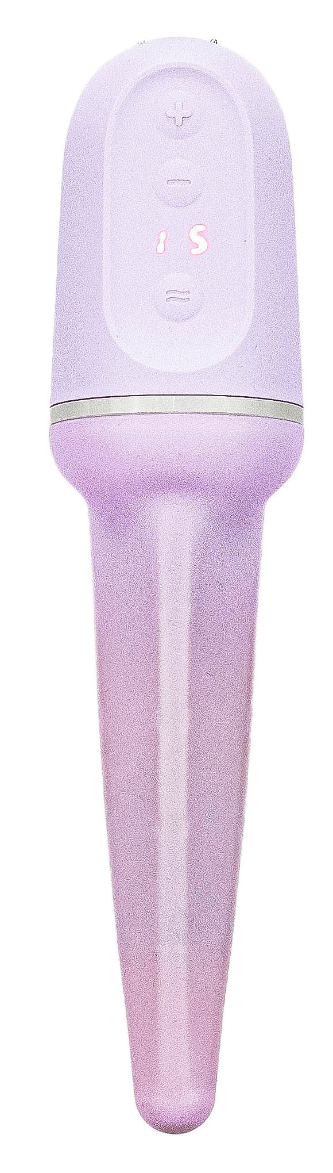
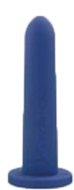

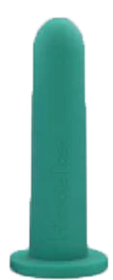
Sizes: Incremental vs Jumps
The Milli maximum dilation average for experienced (32.6 mm) and naïve (32.3 mm) participants falls between sizes 6 and 7 in two commonly used 8-device static kits.
Participant verbatim:
“Want to have more intermediate options than my static dilators and also want the vibration option.”
27mm
28mm
29mm
30mm
31mm
32mm
33mm
34 mm
Size 6 27.2mm
Size 7 33mm

Slide 13
Conclusion
Results suggest that experienced and naive dilator users may benefit from an expandable dilator, and that experienced users may derive more benefit from it than they did with static dilators.
A dilator that expands in one-millimeter increments may provide more perceived control at a larger size, perhaps reducing anxiety and being less intimidating than larger static dilators.
Finally, the expandable dilator offers additional benefits, allowing for insertion at a smaller diameter and gradual expansion once inserted, and also provides vibration.
The hard-to-treat population of participants who previously failed with static dilators takes slightly longer to see improvements but can achieve successful intercourse within 6 months.

Slide 14
References
Tucker S, Javaid S, Rubin R. Accuracy of online patient self-diagnosis of vaginismus/genito-pelvic pain/penetration. Presented at: 25th Annual Fall Scientific Meeting of SMSNA. Scottsdale, Arizona. October 17-20, 2024. (Self-Selection Study)
van Lankveld JJ. J Consult Clin Psychol. 2006 Feb;74(1):168-78. (PEQ)
Rosen, R., Brown, C., Heiman, J., Leiblum, S., Meston, C., Shabsigh, R., Ferguson, D., & D’Agostino, R. (2000). The Female Sexual Function Index (FSFI): A multidimensional self-report instrument for the assessment of female sexual function. Journal of Sex & Marital Therapy, 26(2), 191-208. (FSFI)
Huskisson, E. C. (1974). Measurement of pain. The Lancet, 304(7889), 1127-1131. (VAS Pain and Anxiety)

